Slide 1
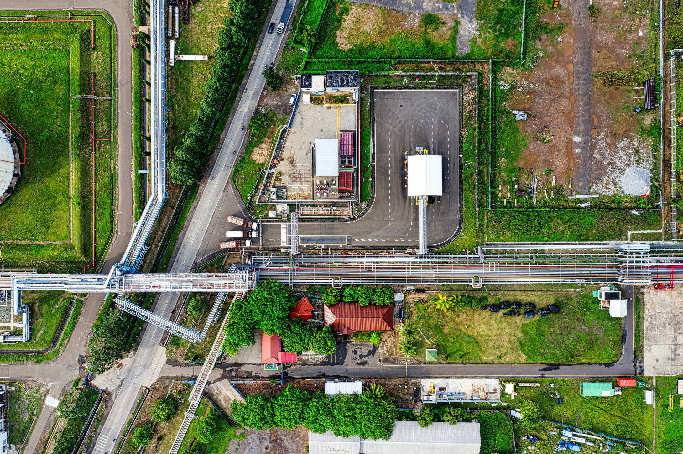
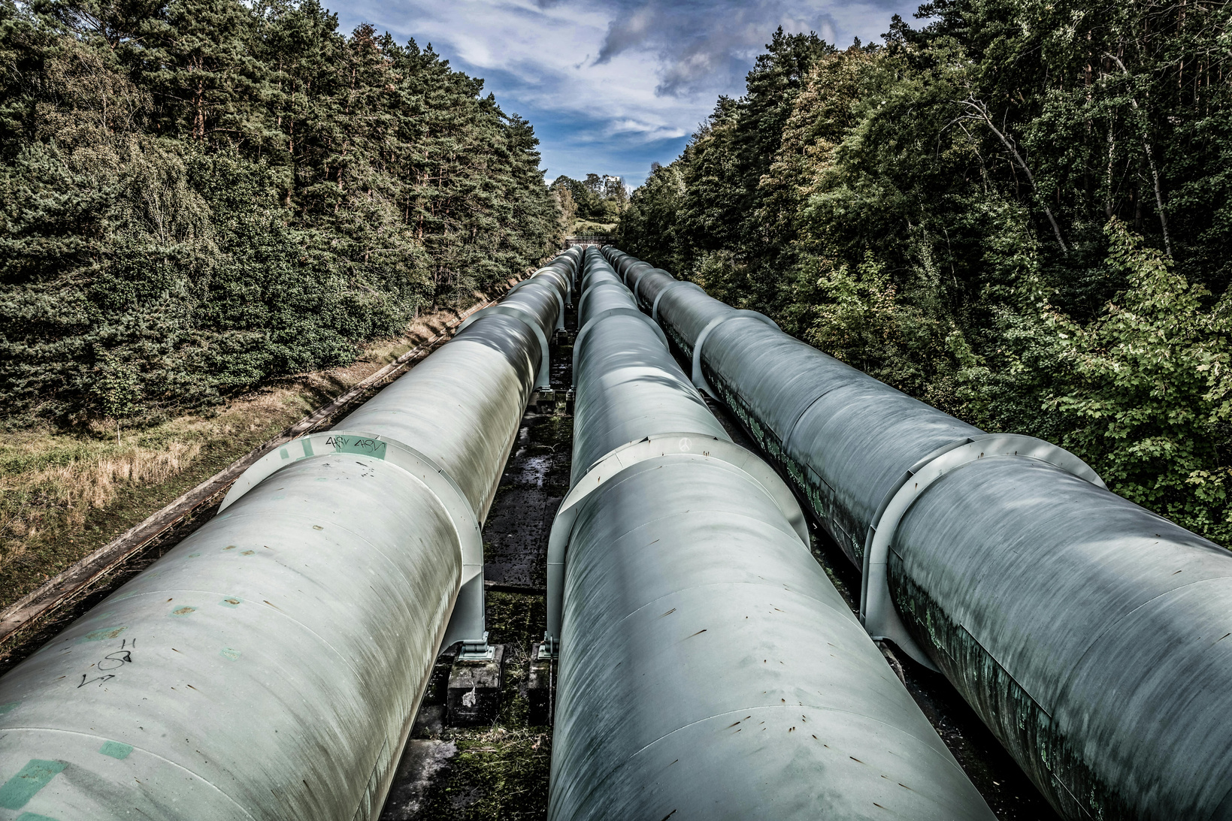
Enhancing Water Transport Efficiency Through Geospatial Risk Modeling
Transforming multimodal open data into decision making
Candidate
Supervisors
Rafael Urbina Hincapie
Prof. Gualtiero Fantoni
Prof.ssa Irene Spada
Master thesis
Student in Data science and business informatics
Notes:
Introduction

Slide 2
Context
How can we define the vulnerabilities of a Water distribution networks?
Problem framing
Shifting the Dimensions of Risk
The Foundation (Sangroula et al., 2026)
Physical
Environmental
Operational
Our Approach
The Challenge: Missing or inaccessible structural physical pipeline data.
The Solution: Pivot the problem structure to exploit the vast availability of Open Data in the remaining two dimensions.
Focus Area: Building a flexible risk framework driven entirely by Environmental and Operational indicators.
Case study & geospatial scope
Notes:
Italy’s hydrology is defined by its mountain ranges, which create distinct drainage basins flowing into the Adriatic, Tyrrhenian, and Ionian seas.
The Po River Basin: Covering nearly 15% of Italy, the Po is the nation's "breadbasket." It is an Alpine-fed system, meaning it relies heavily on snowmelt and glaciers.
The Tiber (Tevere): The primary basin of Central Italy, essential for the water security of Rome and surrounding regions.
Adige and Arno Basins: The Adige (North-East) and Arno (Tuscany) are critical for both irrigation and urban supply, though they are increasingly subject to "flashy" hydrological behavior (sudden floods followed by dry spells).
Karst Springs: Much of Southern Italy and the islands rely on karst aquifers—underground limestone systems that act as natural reservoirs but are highly sensitive to pollution and over-extraction.
Integrating the movement and behaviors of all these zones together can be challenging

Slide 3
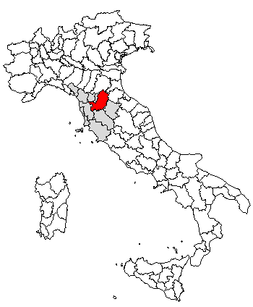
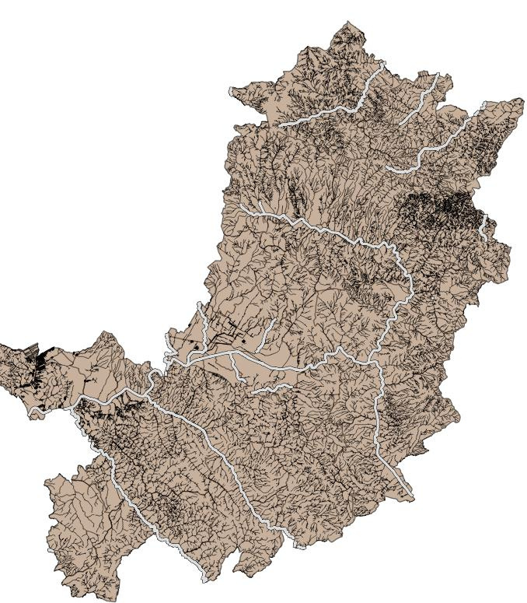
Florence Province
Context
How can we define the vulnerabilities of a Water distribution networks?
Problem framing
Shifting the Dimensions of Risk
The Foundation (Sangroula et al., 2026)
Physical
Environmental
Operational
Our Approach
The Challenge: Missing or inaccessible structural physical pipeline data.
The Solution: Pivot the problem structure to exploit the vast availability of Open Data in the remaining two dimensions.
Focus Area: Building a flexible risk framework driven entirely by Environmental and Operational indicators.
Case study & geospatial scope
Province of Florence (Firenze) initial phase.
Initial scope manageable and controlled.
Designed to scale the methodology across the Italian territory.
Standardized Uber H3 grid
Instead of mapping specific points we map zones
If a pipeline is inside the zone, how hazardous would it be?
Notes:
Italy’s hydrology is defined by its mountain ranges, which create distinct drainage basins flowing into the Adriatic, Tyrrhenian, and Ionian seas.
The Po River Basin: Covering nearly 15% of Italy, the Po is the nation's "breadbasket." It is an Alpine-fed system, meaning it relies heavily on snowmelt and glaciers.
The Tiber (Tevere): The primary basin of Central Italy, essential for the water security of Rome and surrounding regions.
Adige and Arno Basins: The Adige (North-East) and Arno (Tuscany) are critical for both irrigation and urban supply, though they are increasingly subject to "flashy" hydrological behavior (sudden floods followed by dry spells).
Karst Springs: Much of Southern Italy and the islands rely on karst aquifers—underground limestone systems that act as natural reservoirs but are highly sensitive to pollution and over-extraction.
Integrating the movement and behaviors of all these zones together can be challenging

Slide 4

Research question & objectives
Main Research question
How can multimodal open data and patent data be used to reduce inefficiencies in water transportation systems through pipelines?

Slide 5

Research question & objectives
Secondary objectives
Secondary objectives
To identify and systematically catalog diverse repositories of multimodal open data and global patent databases relevant to the Italian water transport system.
To establish a comprehensive methodology for the integration and harmonization of heterogeneous datasets, ensuring interoperability between various knowledge fields and from structured to unstructured data.
Main Research question
How can multimodal open data and patent data be used to reduce inefficiencies in water transportation systems through pipelines?
Secondary objectives
To design a data-driven framework that utilizes integrated insights built on causes and effects to support the prioritization of infrastructure interventions and the optimization of resource allocation.

Slide 6
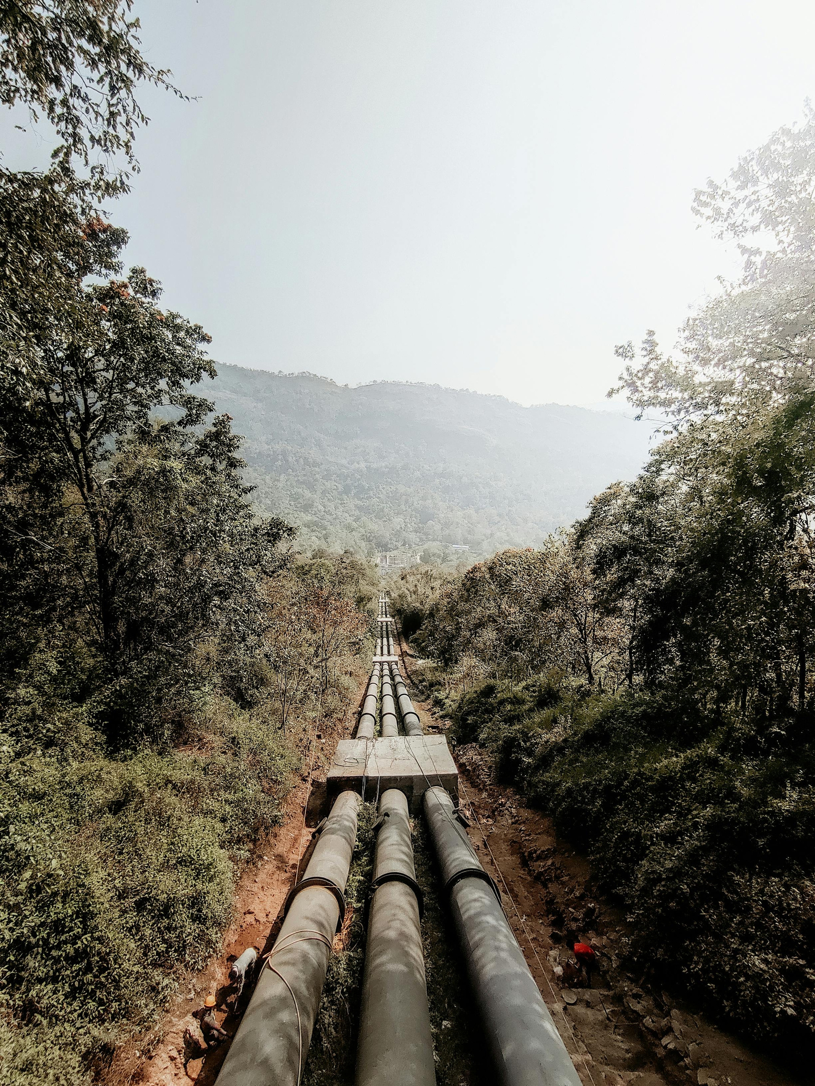
Methodology framing
How can we pair causes with solutions?
Approach
Vulnerability layer & Mitigation layer
Vulnerability layer
Compiles all collected spatial layers into a single, unified index for every individual H3 hexagon cell.
Output a single risk score; and calculates Feature Importance metrics.
It breaks down the exact percentage of why a specific hexagon is risky (e.g., 70% Slope, 20% Soil Type, 10% Rainfall).
Notes:
Globally, water supply and wastewater systems account for approximately 2–4% of total electricity consumption, with pumping being the dominant contributor.
In Italy, structural inefficiencies further amplify this issue. National statistics indicate that over 40% of potable water is lost before reaching end users, implying that large volumes of water are pumped, transported, and pressurized without delivering any societal benefit. In long-distance systems, these losses translate directly into wasted energy and unnecessary emissions.
Climate-related hazards compound the problem. A significant share of Italian pipeline infrastructure intersects areas classified as high seismic risk, landslide-prone zones, or flood-exposed regions, increasing the likelihood of service disruption and emergency energy use during extreme events. At the same time, climate change is increasing drought frequency, reinforcing dependence on inter-basin transfers and long-distance conveyance.
Despite these pressures, decision-makers often lack integrated indicators that jointly capture energy intensity, climate exposure, and infrastructure vulnerability. Data exists across environmental, energy, and infrastructural domains, but remains fragmented and underutilized.

Slide 7
Methodology framing
How can we pair causes with solutions?
Approach
Vulnerability layer & Mitigation layer
Vulnerability layer
Mitigation layer
Compiles all collected spatial layers into a single, unified index for every individual H3 hexagon cell.
Output a single risk score; and calculates Feature Importance metrics.
It breaks down the exact percentage of why a specific hexagon is risky (e.g., 70% Slope, 20% Soil Type, 10% Rainfall).
The system ingests the Risk Index and the Feature Importances generated by the vulnerability layer.
Rather than giving generic warnings, it cross-references the hazard profile of the hexagon (e.g., high soil acidity or steep slope).
The system automatically recommends specific patented engineering solutions tailored precisely to mitigate the risks of that area.
Notes:
Globally, water supply and wastewater systems account for approximately 2–4% of total electricity consumption, with pumping being the dominant contributor.
In Italy, structural inefficiencies further amplify this issue. National statistics indicate that over 40% of potable water is lost before reaching end users, implying that large volumes of water are pumped, transported, and pressurized without delivering any societal benefit. In long-distance systems, these losses translate directly into wasted energy and unnecessary emissions.
Climate-related hazards compound the problem. A significant share of Italian pipeline infrastructure intersects areas classified as high seismic risk, landslide-prone zones, or flood-exposed regions, increasing the likelihood of service disruption and emergency energy use during extreme events. At the same time, climate change is increasing drought frequency, reinforcing dependence on inter-basin transfers and long-distance conveyance.
Despite these pressures, decision-makers often lack integrated indicators that jointly capture energy intensity, climate exposure, and infrastructure vulnerability. Data exists across environmental, energy, and infrastructural domains, but remains fragmented and underutilized.

Slide 8
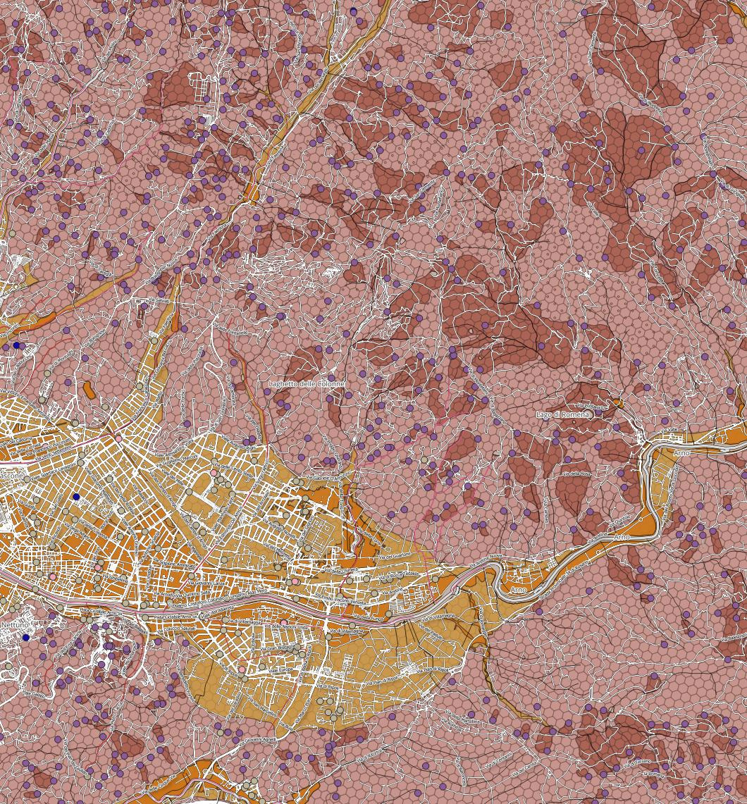



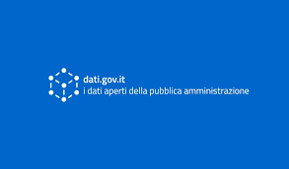
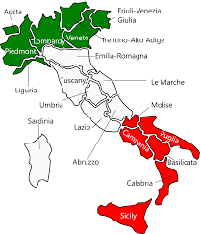





Preliminary exploration EUROSTAT & ISTAT
Dati.gov.it and ARPA entities
Open data regional sites
Data sources
Main sources by content
Official National Hazard Inventories for landslides, floods, seismicity and wildfires
Decades of localized rain , temperature, humidity and wind gust history
Communal income and population census
Pedological soil databases, sentinel-1 soil displacement points
Streets, infrastructural assets, waterways (OSM)
Pendolarismo, daily commutters between communes
Natural disasters interventions
High-resolution DTMs
Multimodal, reliable and open access
Environmental risk sites and Patent data
Programs like SIR from Regione toscana, IdroGEO from Isprambiente, CFTI landslides from the national institute of geophysics and vulcanology (INGV) and Copernicus crops data.
Patent data enhances technical knowledge about the physical factors that affect the pipeline systems at hand
Notes:
In Istat and Eurostat we found data about water sources, sewage sources, energy consumption data, energy flow data, geological data (risks), Economic factors, Transportation through pipelines (Oil and Gas), Geo data like elevation, grids of transportation services, land use.

Slide 9
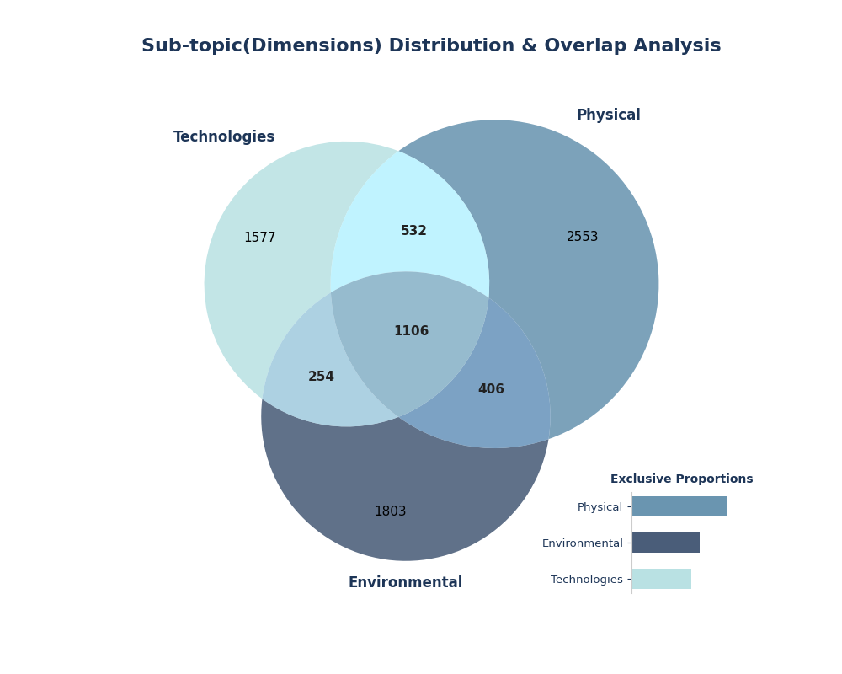
Patents retrieval
Retrieval strategy
Extracted a comprehensive macro-pool of global patents targeted at:
Water distribution networks
Bulk water transportation
Sewage and wastewater infrastructure
The classification dimensions
Physical: Structural pipeline faults, joints, reinforcements, and physical assets.
Environmental: Soil stabilization, erosion control, and external terrain-defense solutions.
Technologies: Digital systems, monitoring tools, smart valves, and software layers.

Slide 10
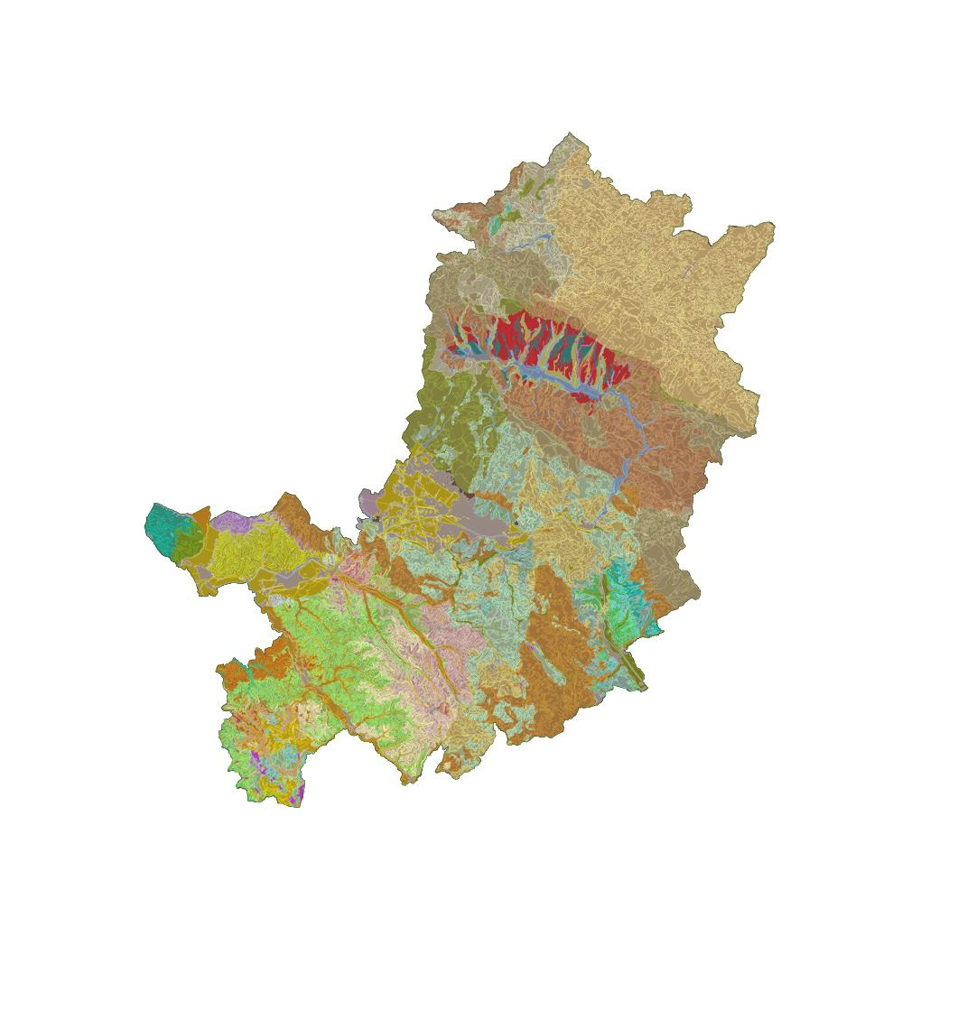
Methodology
Creating a framework for the risk assesment solutions
Data cube structure
Generate a star schema that allows the system to separate highly granular data from static data, thus allowing the risk assessment to be made with the contextual information of the static properties, plus the situational conditions that change in a daily, weekly or monthly basis
Causes
Conditions
Effects
- Seismic/site intensity
- Rain
- Temperature anomalies
- Wind gust anomalies
- Wildfires (EFFIS)
- Pendolarismo daily commuters
- DTM’s
- Soil data, pedologia
- Idrografia
- Streets and water ways
- Infrastructure
- Interventions
- Economical data
- Population census
- Landslides/Floods history
- Sentinel1 soil displacement points
Notes:
1ST: The paper provides a blueprint for integrating heterogeneous data sources—including SCADA, GIS, and EPANET—with external information like weather data and social media to create a uniform geo-referenced view, W2S is specifically engineered to identify non-revenue water, real-time leakages, bursts, and even fraud, addressing the core inefficiencies in pipeline systems.
2ND: introduces a multimodal big data analytics pipeline (FAIS) designed to enhance situational awareness and assess potential impacts on critical infrastructures, It provides a framework to seamlessly integrate fragmented data, combining USGS river levels, traffic camera imagery, and Twitter APIs into a single web-based dashboard, The system leverages Natural Language Processing (NLP) and Google Vision API to identify "abnormal" conditions and detect at-risk locations programmatically.
3RD: It provides a blueprint for integrating multimodal sensing with cloud-based machine learning for critical water infrastructure, It moves beyond basic threshold alerts by using a Random Forest classification model to analyze complex patterns across multiple parameters (pH, TDS, turbidity, and temperature) to assess water potability in real-time.
4TH: The research highlights significant performance benchmarks, including a 20% increase in wastewater treatment efficiency and up to 86% predictive accuracy for resource management, It advocates for smart contract-driven automation to track water rights and aquifer usage in real-time, reducing the need for manual stakeholder audits,By combining distributed ledgers with Deep Learning (e.g., LSTM models), the framework enables more robust identification of leakages, illegal extraction, and operational failures.

Slide 11
Conclusions
A risk model in it’s early phases
Value of the proposal
The project works on open data thus readily available for anybody to use, no private data (thus far)
The model is highly scalable to cover the whole country, since the data is collected mostly with a remote sensing methodology
The model could be used for other risk related fields in italy aside from WDS, since it has a big component of environmental risk
Thank you for your attention!
By being in the initial phase, there’s still things to change and improve
Any suggestions you might have regarding the data: collection, methodology structure or the connection between risk and patents are very welcome
Negatives of the proposal
The model does not include insitu physical properties of the pipelines, reducing technical information but increasing flexibility
The project is based on environmental, economical and social sources which can have low granularity
The model thus far does not contain a label which serves as a control group for the risk assessment

